Slide 1

Department of Cyber Security and Forensic Computing College of Computer and Cyber Sciences
Project title: Investigation of Data Collecting by Smartwatch
Digital Forensic -FC302
Instructors: Noura, Naveed, Wajiha
Students :
Bashayer 4210396
Sara 4110003
Lobna 4110171
Rewaa 4110191
YOSRA 4110212

Slide 2
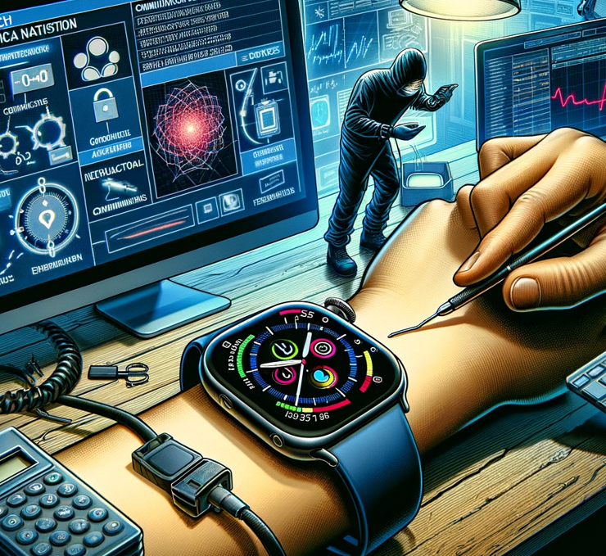
Introduction

Slide 3
Real Examples :
In 2017, forensic evidence from a Fitbit was crucial in the conviction of a man suspected of killing his wife in Connecticut, USA [1].
In the UK, data retrieved from a Garmin smartwatch was used to convict a British runner for the murder of two gangsters [2].

Slide 4
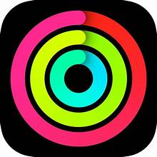
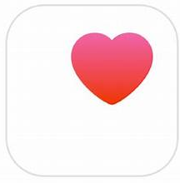
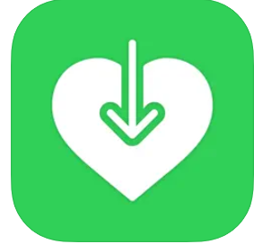
The methodology used to collect and extract data:
Fitness app
Health app
Health export
Fitness app used to record health-related data collected by the Apple Watch.
The Health app is used to extract all the data collected by the Fitness app in XML format.
Health export is used to analyze the XML file extracted from the Health app and convert the XML file to CSV.

Slide 5
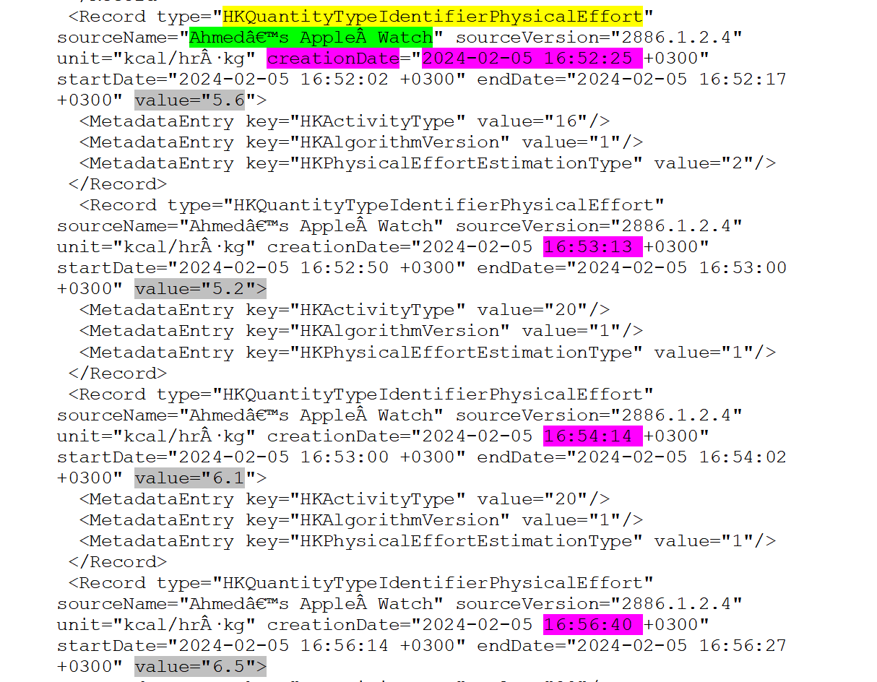
Physical Effort Amount and Duration:
This data proves that the suspect was making a physical effort (exercising) for the duration of 16:52-16:56 during the incident time which is 15:30-17:00

Slide 6
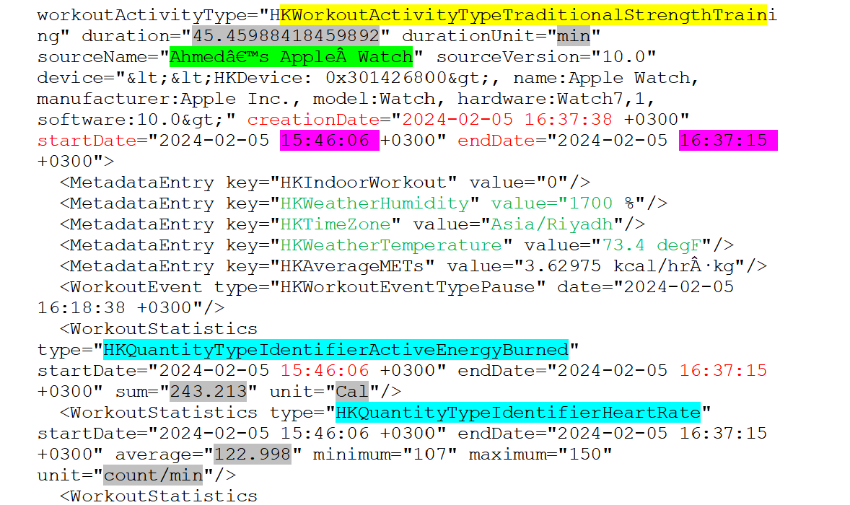
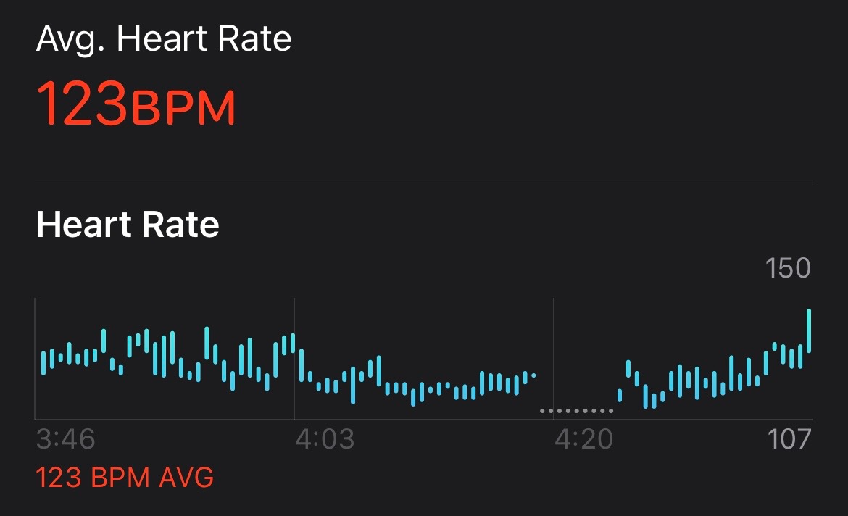
Activity details 1:
When the suspect started his first exercise which was “Traditional strength training” according to the watch, it recorded details about his activity including :
Duration, Start and End time, weather info, time zone, temperature, energy burned, and heart rate.
- As we can see the duration of the first exercise, energy burned, and heart rate indicate that he was exercising for 45 minutes without stopping from 15:46 until 16:37 in the duration of the incident.

Slide 7
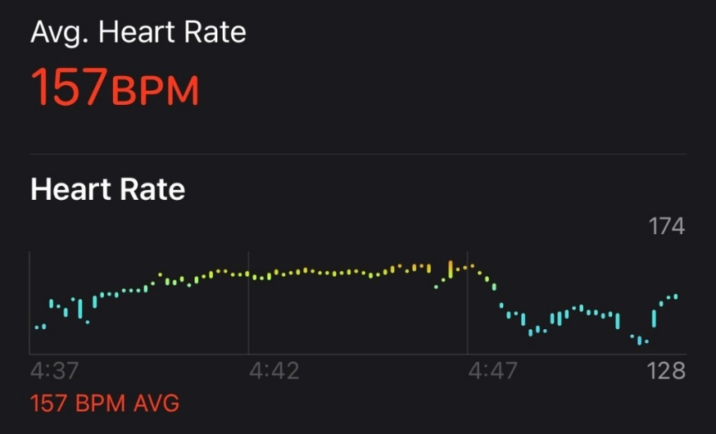
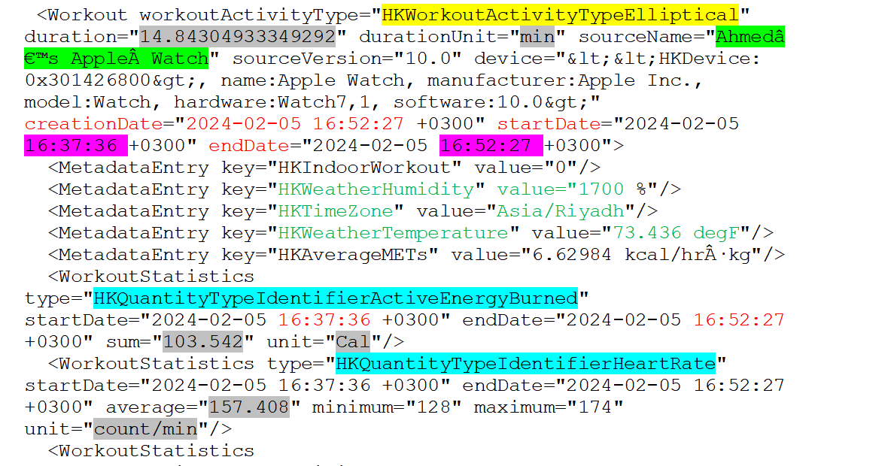
Activity details 2:
Then he started his second exercise “Elliptical” with a duration of 14 minutes based on the start time of 16:37 and end time of 16:52 according to the watch :

Slide 8
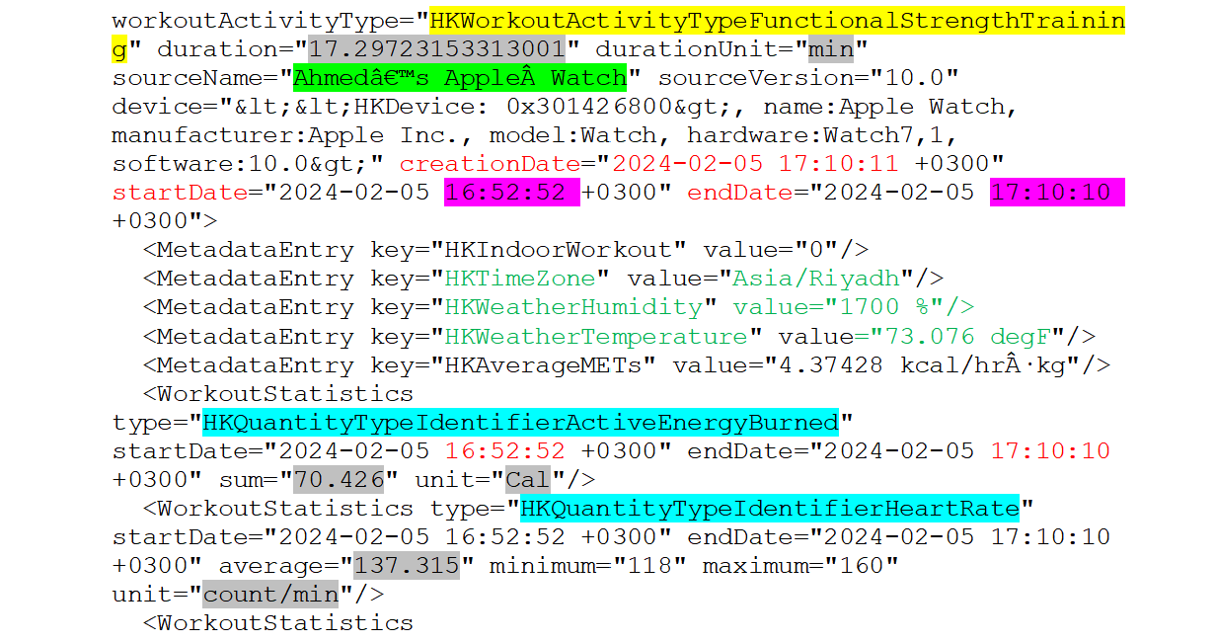
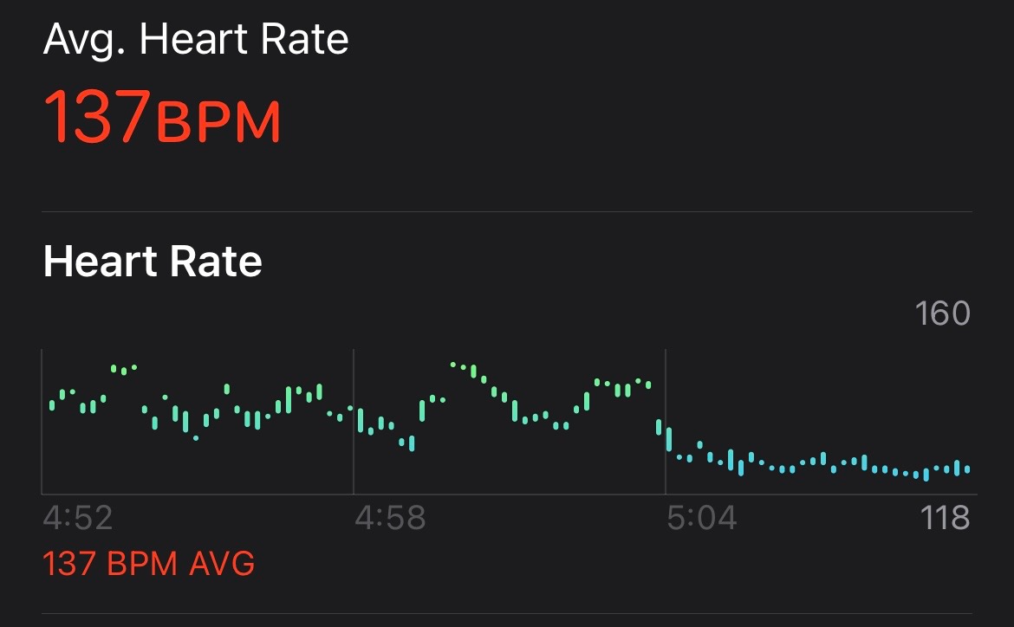
Activity details 3:
After stopping for 25 seconds from the previous exercise he started his third exercise which was “Functional Strength Training” according to the watch, for a duration of 17 minutes and he ended at 17:10 :

Slide 9
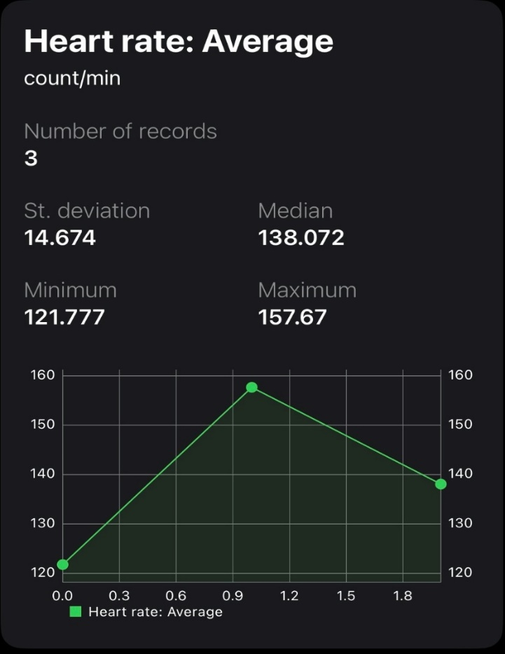
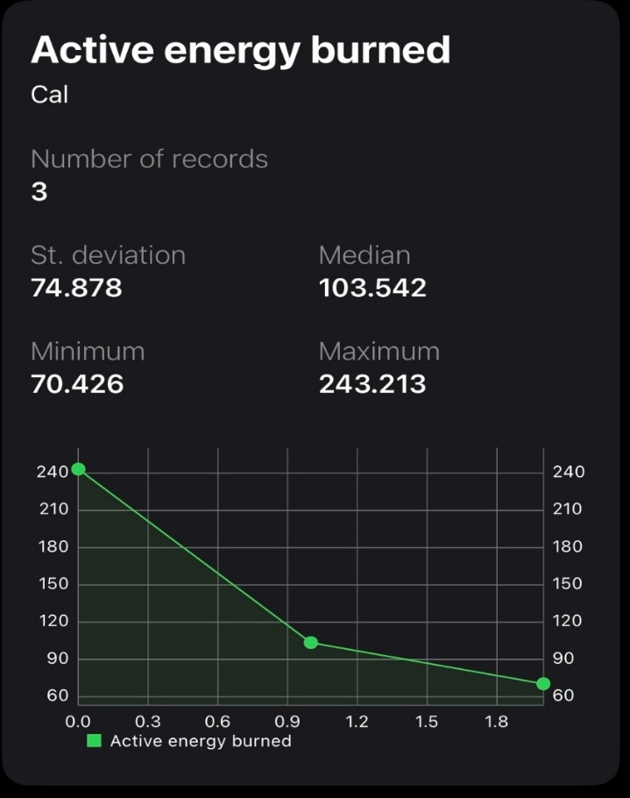
Health Export App visualizing XML data collected from the health app :
Average heart rate on 5-2-2024
Active energy burned on 5-2-2024
During the three exercises

Slide 10
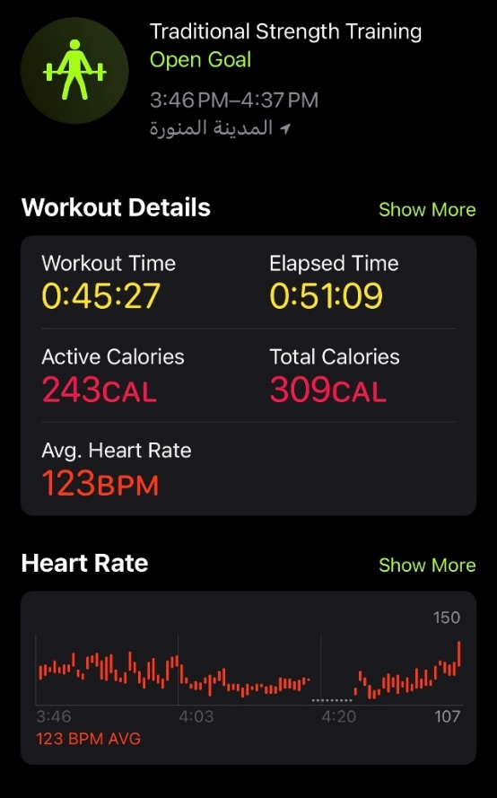
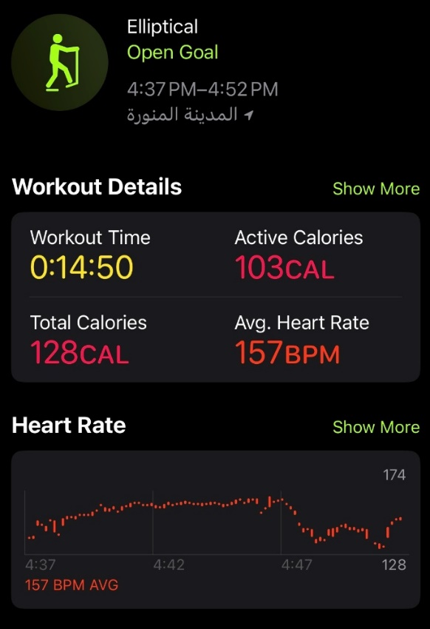
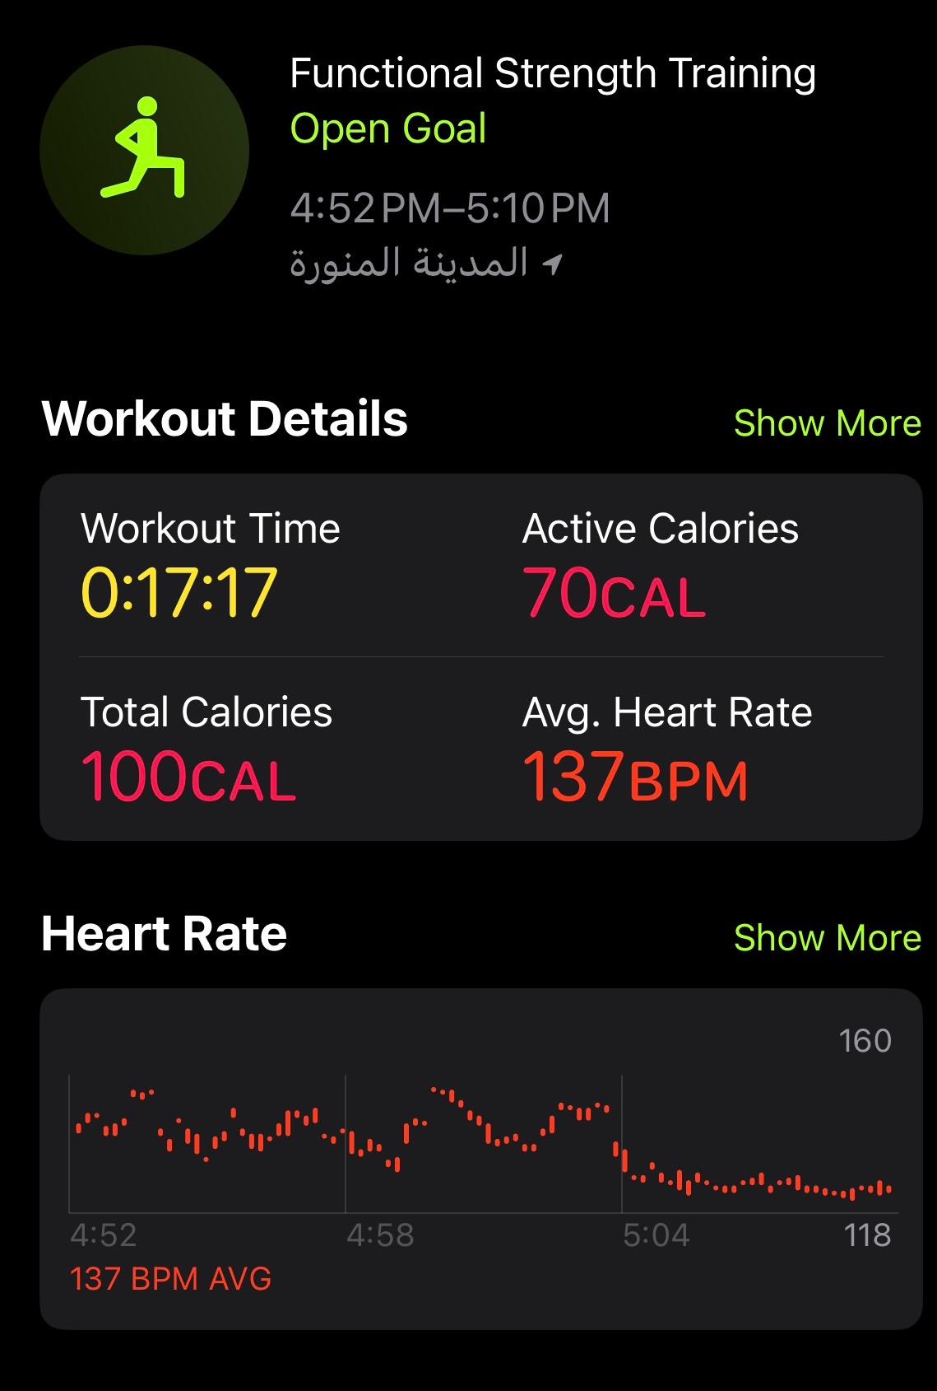
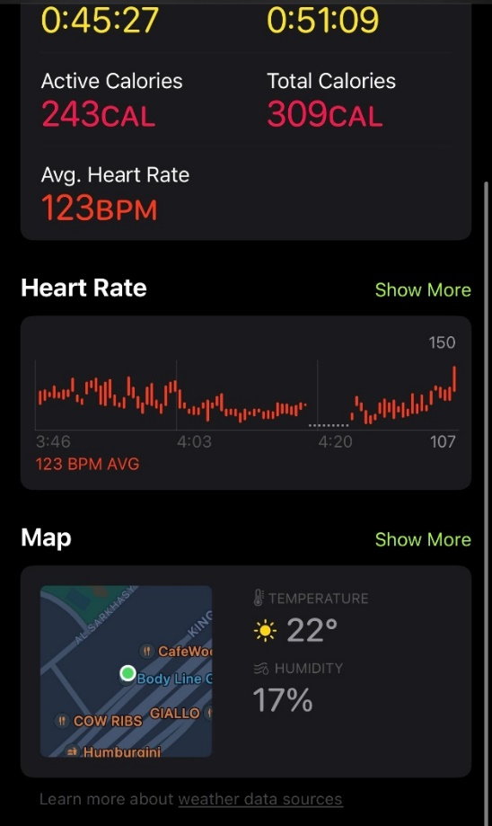
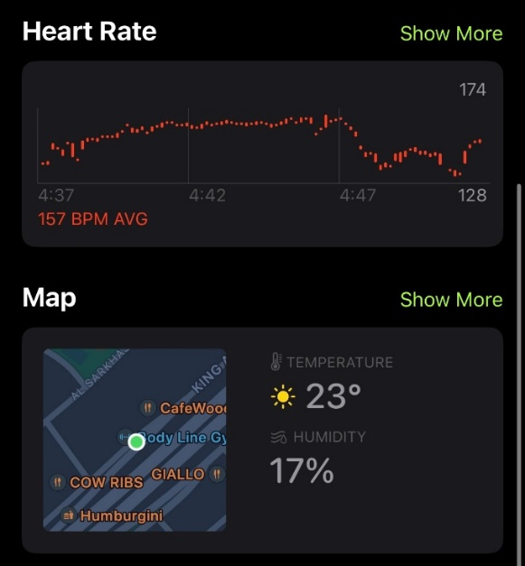
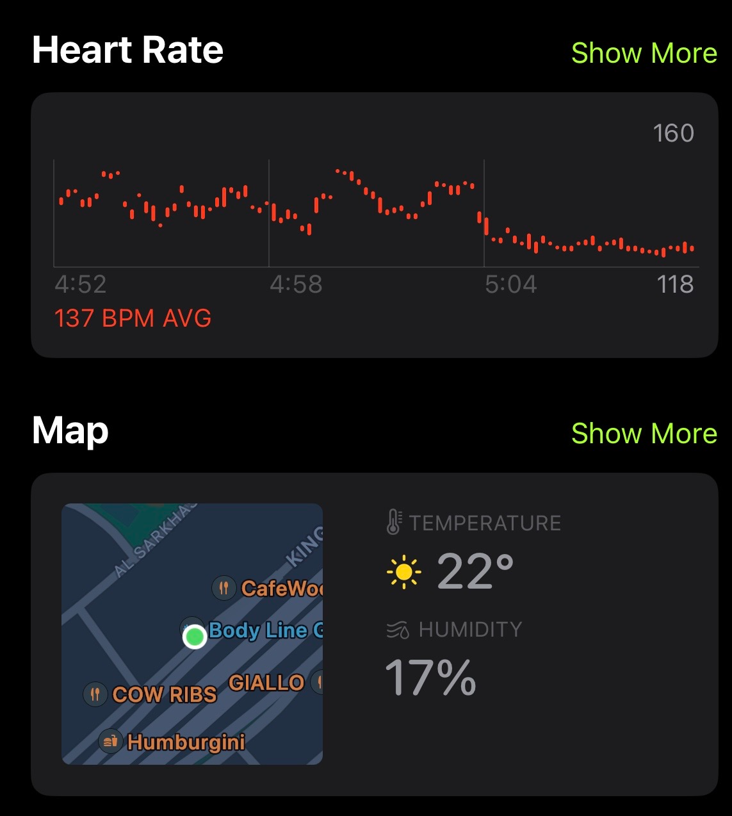
Fitness app view: from the app, we can see the accurate location of the suspect during each exercise:

Slide 11
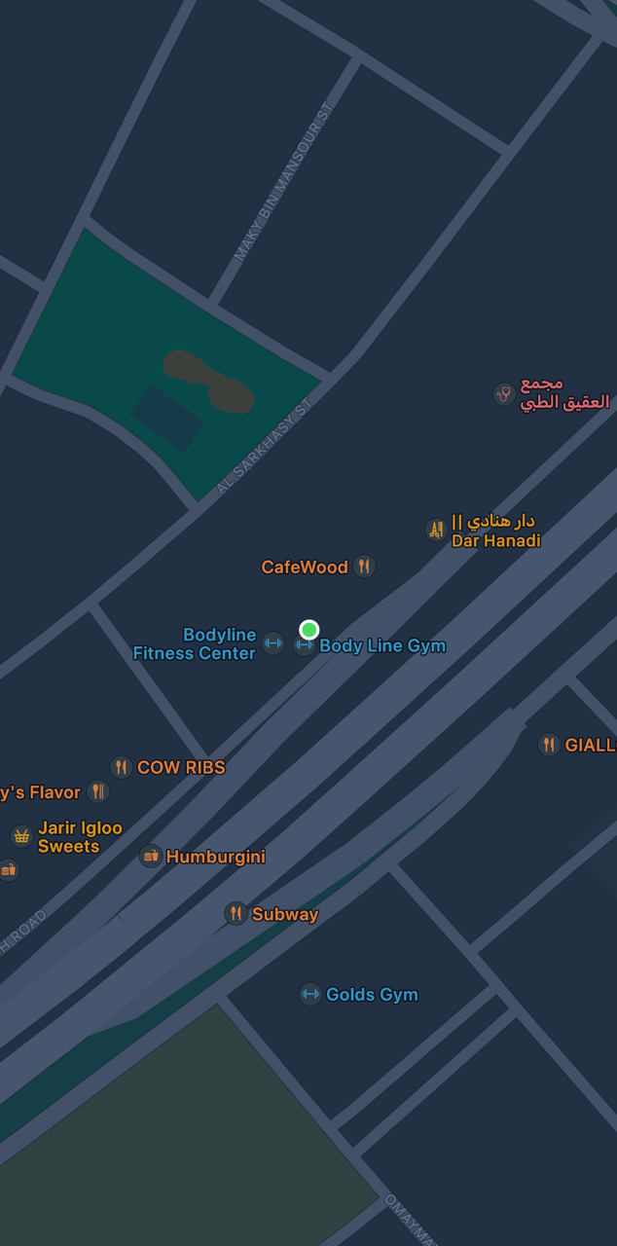
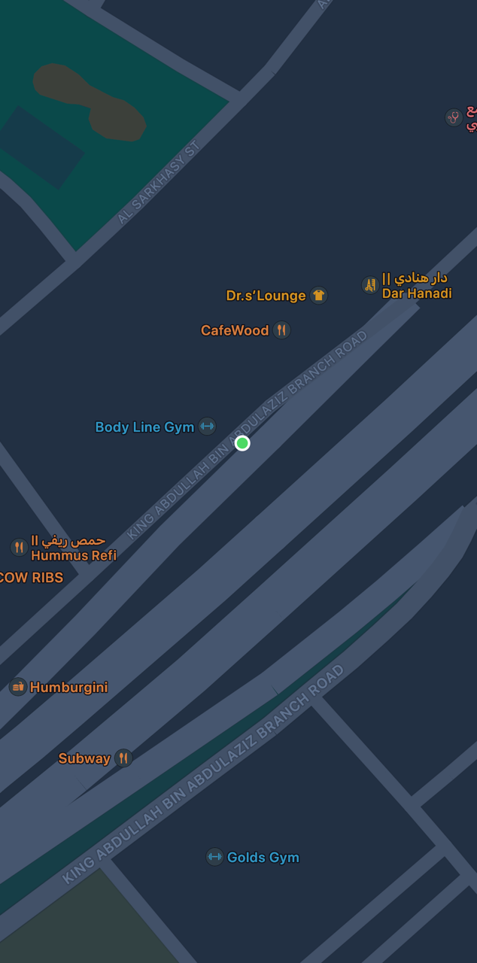
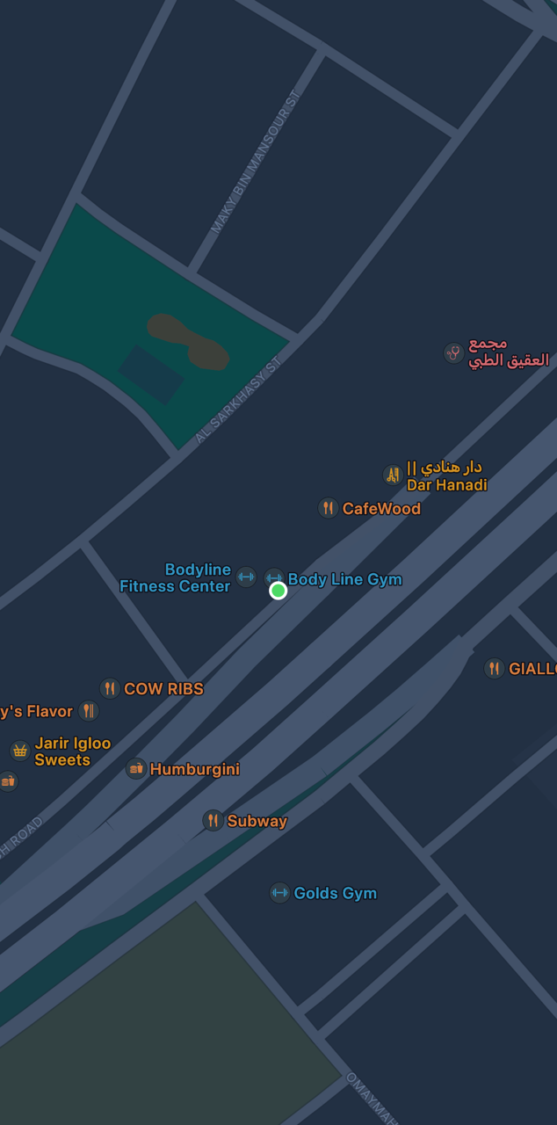
as we can see all locations prove that he was in the gym as he said:

Slide 12
After examining the smartwatch, investigators discovered that 1- the suspect, who works in the stable, was present in the gym from 15:45 to 17:10 during the incident, as indicated by (GPS) data. 2- The distance between the gym and the stable is a trip that takes approximately two hours. So, he managed to reach the stable at 19:00 a few minutes before his owners, who discovered the crime only at 19:03, and since we proved that he was exercising between 15:30 and 17:10 this proves he is innocent.

Slide 13
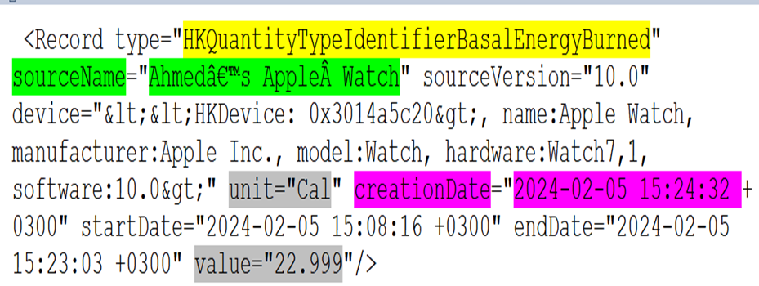
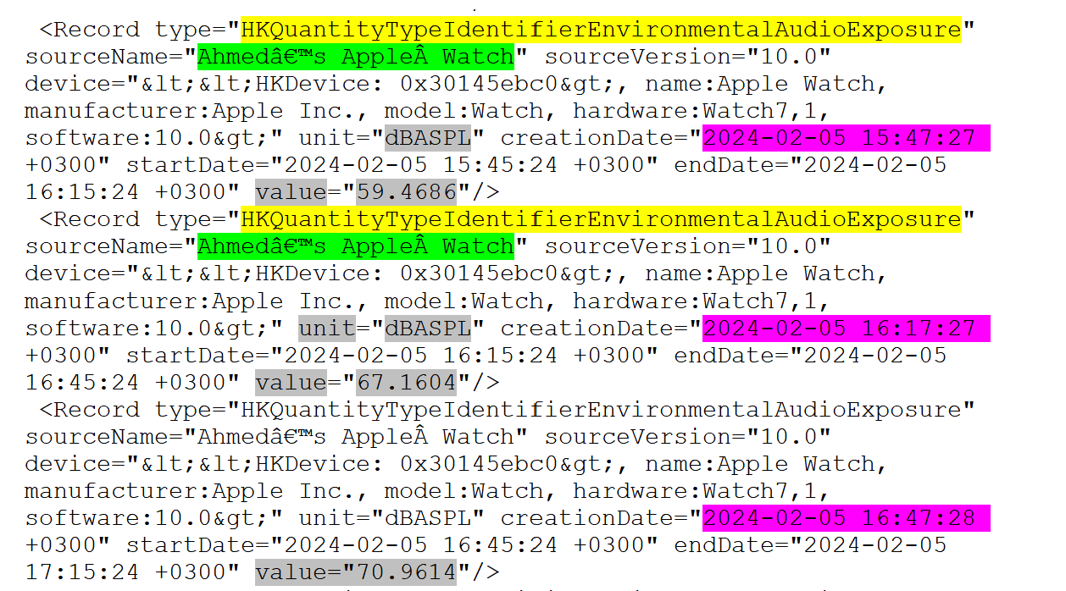
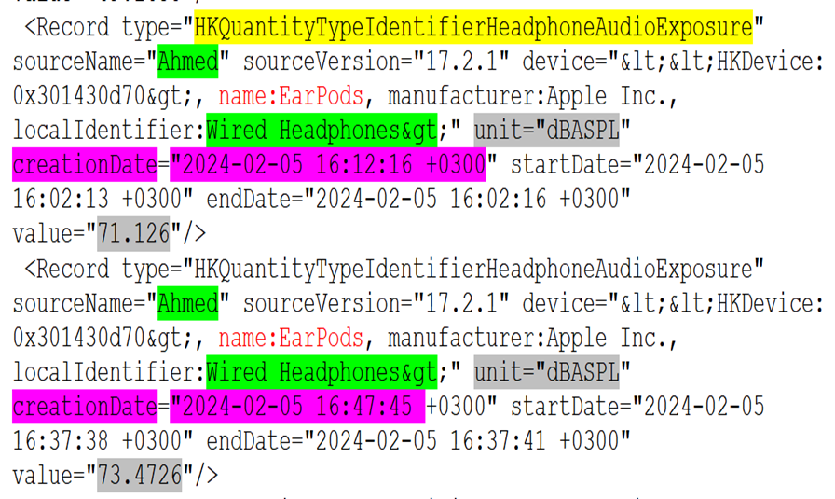
Extra examples of data collected by the Apple watch:
Amount of Energy Burned and duration.
Environmental Audio Exposure.
Headphone Audio Exposure.
Blood pressure
Time of standing
Floor climbed
Includes: (Source Name, version, device, value, and creation, start and end time)

Slide 14
Conclusion:
Smartwatches, designed primarily for fitness tracking and activity monitoring, generate extensive user data, including body movements, biometric indicators like heart rate and energy burned, and GPS location tracking. This makes it a valuable source of evidence in criminal investigations, aiding in convicting or acquitting criminals.

Slide 15
References:
Hauser, In Connecticut Murder Case, a Fitbit Is a Silent Witness, New York Times, 2017. https://www.nytimes.com/2017/04/27/nyregion/in-connecticut-murder-case-a-fitbit-is-a-silent-witness.html (Accessed 4 May 2020).
M. Kelly, Garmin data used to convict British runner for the murder of two gangsters Verge. Com., 2019. https://www.theverge.com/2019/1/18/18188205/garmin-data-iceman-murder-mr-big-amazon-alexa (Accessed 26 February2021).

